Slide 1
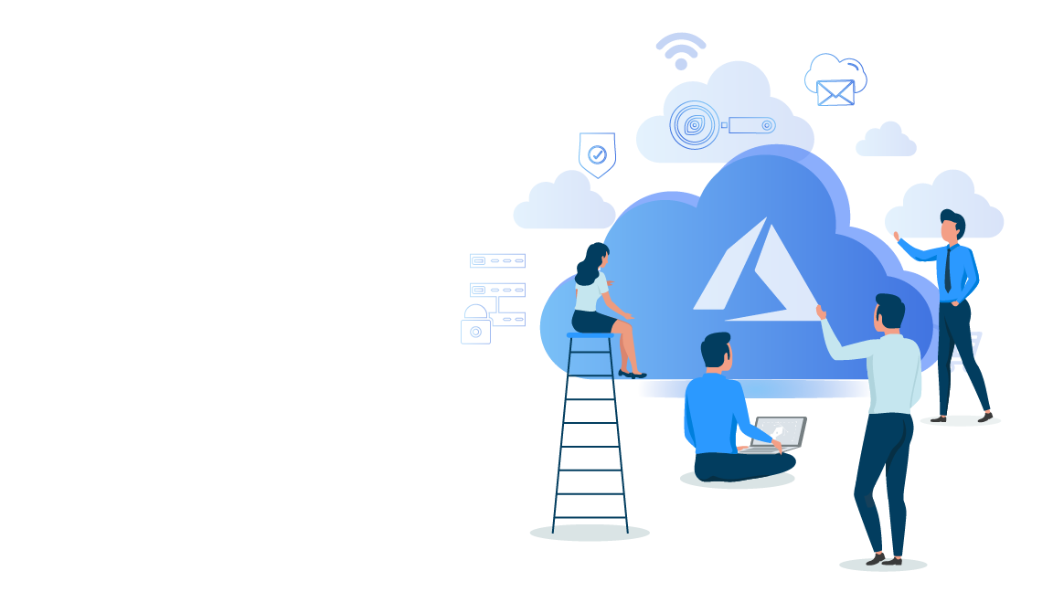


Microsoft Azure Administrator Associate Training(AZ-103)
Module 4

Slide 2
Agenda
Introduction To Microsoft Azure Virtual Network
05
Vnet Peering
09
IP Addresses In Azure Vnet
01
06
Hands-On: Create and Configure Vnet Peering
10
IP Address Allocation Method
02
Vnet Components
Hands-On: Create a Vnet
07
Vnet To Vnet Connection Gateway
11
Hands- On: Assign Static IP to a VM
03
08
Hands-On: Create a Vnet to Vnet Connection Gateway
12
04
Connecting Different Vnets
Azure Vnet Routing

Slide 3
Agenda
13
Hands-On: Create a Route Table
13
Azure DNS
17
Network Security Groups
14
14
18
Hands-On: Create NSG
Azure Network Interface
Why Azure DNS
15
Create and Attach NIC to a VM
15
Hands-On: Create a DNS Zone
19
Security Rules
16
Subnets In Azure VNet
16
Azure Private DNS
20
Security Rule Properties

Slide 4
Agenda
21
23
Quiz
Service Tags

Slide 5
Introduction to Microsoft Azure Virtual Network

Slide 6
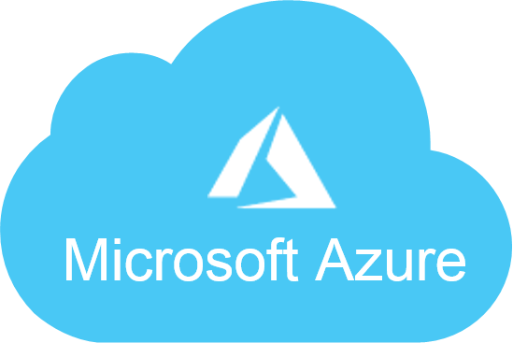

Introduction to Microsoft Azure Virtual Network
Azure Virtual Network (VNet) is the fundamental building block for your private network in Azure. VNet enables many types of Azure resources, such as Azure Virtual Machines (VM) to securely communicate with each other, the Internet, and on-premises networks

Slide 7
Vnet Components

Slide 8

VNet Components
An Address Space is a range of IP Addresses. Azure will assign the next available IP Address from this address space to a resources in your virtual network.
Address space
Subnets
Regions
Subscription

Slide 9
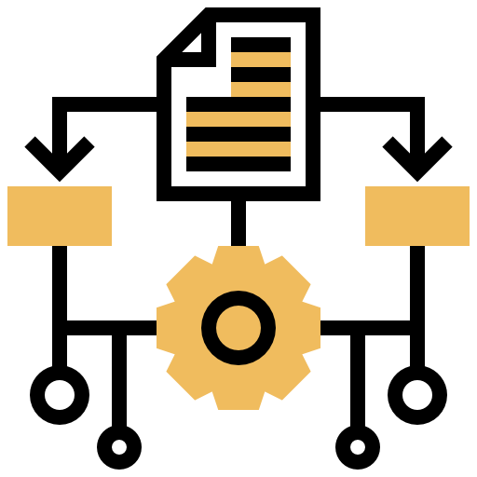
VNet Components
A Subnet is a logical segment of a Virtual Network. A Subnet is allocated a portion of a the virtual network's address space
Address space
Subnets
Regions
Subscription

Slide 10
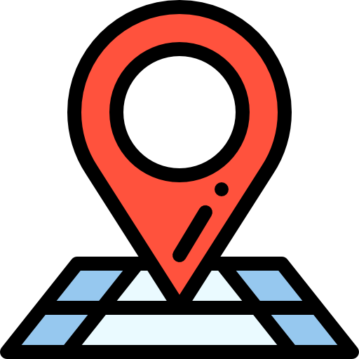
VNet Components
Virtual Networks are scoped to a single location called a region. Multiple virtual networks from different regions can be connected together using Virtual Network Peering
Address space
Subnets
Regions
Subscription

Slide 11

VNet Components
Virtual Networks are scoped to a subscription. You can implement multiple virtual networks within each Azure subscription and Azure region.
Address space
Subnets
Regions
Subscription

Slide 12
Hands-on: Create VNET

Slide 13
Connecting Different VNets

Slide 14
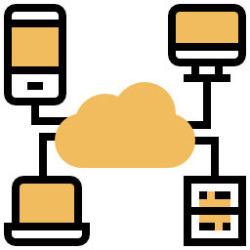
Connecting different VNets
There are two ways you can connect your Azure VNets:
1. VNet Peering
2. VNet to VNet Connection Gateway

Slide 15
VNet Peering

Slide 16

VNet Peering
Virtual network peering enables you to connect to Azure virtual networks. Once peered, the virtual networks appear as one, for connectivity purposes
The traffic between virtual machines is routed through the Microsoft infrastructure, through private IP addresses only

Slide 17
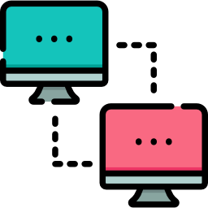

VNet Peering
Azure supports two types of Virtual Network Peering:
VNet peering - connecting VNets within the same Azure region
Global VNet peering - connecting VNets across Azure regions

Slide 18
Hands-on: Create and Configure VNET Peering

Slide 19
VNet to VNet Connection Gateway

Slide 20

VNet to VNet Connection Gateway
You can connect two VNets to each other using VNet-To-VNet VPN gateway connection. This connection type uses a VPN gateway to provide a secure tunnel with IPsec/IKE and functions the same way when communicating

Slide 21
Hands-on: Create a VNET to VNET Gateway Connection

Slide 22
IP Addresses

Slide 23
IP Addresses
You can assign IP addresses to Azure resources to communicate with other Azure resources, your on-premises network, and the Internet.
There are two types of IP addresses you can use in Azure:
1. Public IP addresses: Used for communication with the Internet, including Azure public-facing services
2. Private IP addresses: Used for communication within an Azure virtual network (VNet) and your on-premises network, when you use a VPN gateway or ExpressRoute circuit to extend your network to Azure

Slide 24
IP Address Allocation Methods

Slide 25

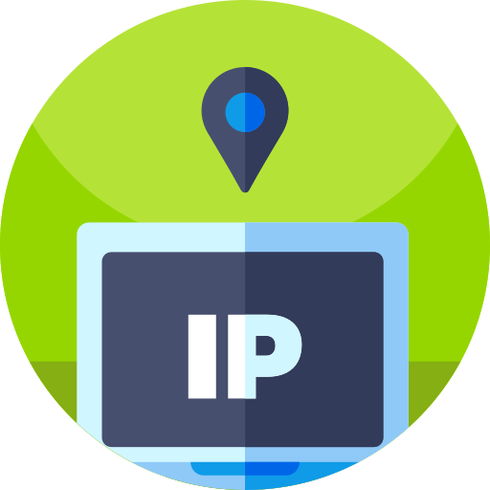
IP Address Allocation Methods
There are two methods in which IP addresses are allocated:
Dynamic: Azure assigns the next available unassigned or unreserved IP address in the subnet's address range
Static: You select and assign any unassigned or unreserved IP address in the subnet's address range
Notes:
Which means that it is a unified space that provides access to blobs, queues, files and tables. Since general purpose storage account supports all type of storage data, it is one of the most used storage account in Azure.

Slide 26


IP Address Allocation Methods
Public and Private IP Allocation:
When a public IP address needs to be assigned to an Azure resource, it is dynamically allocated from a pool of available public IP address within the location the resource is created
A private IP address can be allocated with either Dynamic Allocation or Static Allocation
Notes:
Which means that it is a unified space that provides access to blobs, queues, files and tables. Since general purpose storage account supports all type of storage data, it is one of the most used storage account in Azure.

Slide 27
Hands-on: Assign Static IP to VM

Slide 28
Azure VNet Routing

Slide 29


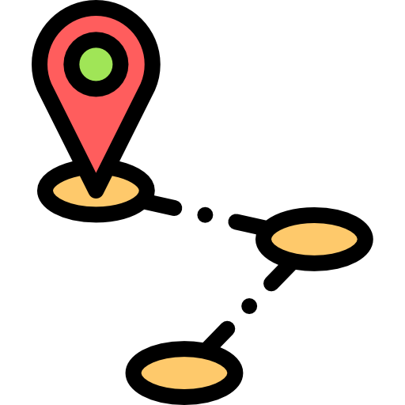
Azure VNet Routing
Routing traffic between different subnets in a virtual network is taken care of by Azure
You can create your own routes to override Azure's default routing
Notes:
Which means that it is a unified space that provides access to blobs, queues, files and tables. Since general purpose storage account supports all type of storage data, it is one of the most used storage account in Azure.

Slide 30
Hands-on: Create a Route Table

Slide 31
Hands-on: Add Route to Route Table

Slide 32
Azure Network Interface

Slide 33
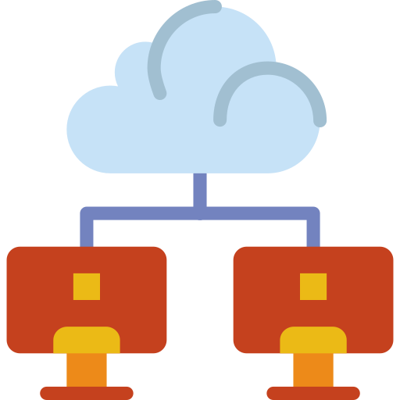

Azure Network Interface
A network interface (NIC) is the interconnection between a Virtual Machine and a virtual network
A VM must have at least one NIC, but can have more than one
Multiple Network Interfaces allow a VM to connect to different subnets and send or receive traffic over the most appropriate interface
Notes:
Which means that it is a unified space that provides access to blobs, queues, files and tables. Since general purpose storage account supports all type of storage data, it is one of the most used storage account in Azure.

Slide 34
Hands-On: Create NIC

Slide 35
Hands-on: Attach NIC to VM

Slide 36
Azure Subnets

Slide 37
Why Subnets?

Slide 38
Azure Subnets
A subnet is a partition of your virtual network in Azure VNet
Having an organization's network divided into subnets allows it to be connected to the Internet with a single shared network address
Subnets were initially designed for solving the shortage of IP addresses over the Internet
Notes:
Which means that it is a unified space that provides access to blobs, queues, files and tables. Since general purpose storage account supports all type of storage data, it is one of the most used storage account in Azure.

Slide 39
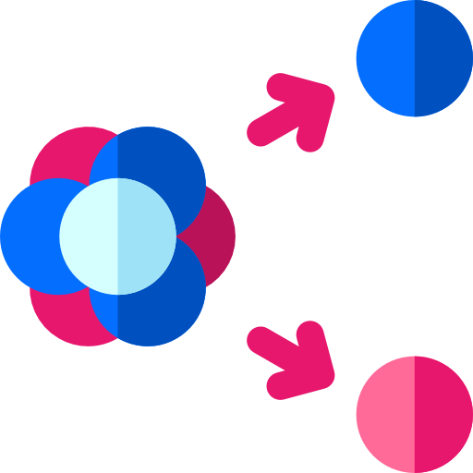
Why Subnets?
Subnetting helps you maintain clean separations within a network. This separation helps in maintaining a large network
Logical divisions
Improved network security
Improved network performance
Notes:
Which means that it is a unified space that provides access to blobs, queues, files and tables. Since general purpose storage account supports all type of storage data, it is one of the most used storage account in Azure.

Slide 40

Why Subnets?
With logical divisions between subnets, you have greater control over who has access to what
Logical divisions
Improved network security
Improved network performance
Notes:
Which means that it is a unified space that provides access to blobs, queues, files and tables. Since general purpose storage account supports all type of storage data, it is one of the most used storage account in Azure.

Slide 41

Why Subnets?
Subnetting reduces the amount of broadcast traffic by containing network broadcasts at the subnet level instead of sending all broadcasts to the entire network
Logical divisions
Improved network security
Improved network performance
Notes:
Which means that it is a unified space that provides access to blobs, queues, files and tables. Since general purpose storage account supports all type of storage data, it is one of the most used storage account in Azure.

Slide 42
Azure DNS

Slide 43

Azure DNS
Azure DNS is a hosting service for DNS domains that provide name resolution by using Microsoft Azure infrastructure.
The Domain Name System, or DNS, is responsible for converting a URI to its IP address
Notes:
Which means that it is a unified space that provides access to blobs, queues, files and tables. Since general purpose storage account supports all type of storage data, it is one of the most used storage account in Azure.

Slide 44

Why Azure DNS?
Reliability and performance
In Azure DNS, each DNS query is responded to by the closest available DNS server
Security
Ease of use
Alias records
Notes:
Which means that it is a unified space that provides access to blobs, queues, files and tables. Since general purpose storage account supports all type of storage data, it is one of the most used storage account in Azure.

Slide 45

Why Azure DNS?
Reliability and performance
Azure DNS is based on Azure Resource Manager (ARM), which provides various security features such as Role-based access control, Activity logs, and Resource locking
Security
Ease of use
Alias records
Notes:
Which means that it is a unified space that provides access to blobs, queues, files and tables. Since general purpose storage account supports all type of storage data, it is one of the most used storage account in Azure.

Slide 46

Why Azure DNS?
Reliability and performance
Azure DNS can manage DNS records for your Azure services and provide DNS for your external resources as well
Security
Ease of use
Alias records
Notes:
Which means that it is a unified space that provides access to blobs, queues, files and tables. Since general purpose storage account supports all type of storage data, it is one of the most used storage account in Azure.

Slide 47

Why Azure DNS?
Reliability and performance
Alias Records are used to refer to an Azure resource, such as an Azure public IP address, an Azure Traffic Manager profile, or an Azure Content Delivery Network (CDN) endpoint
Security
Ease of use
Alias records
Notes:
Which means that it is a unified space that provides access to blobs, queues, files and tables. Since general purpose storage account supports all type of storage data, it is one of the most used storage account in Azure.

Slide 48
Hands-on: Create DNS Zone

Slide 49
Hands-on: Add Record Set to DNS Zone

Slide 50


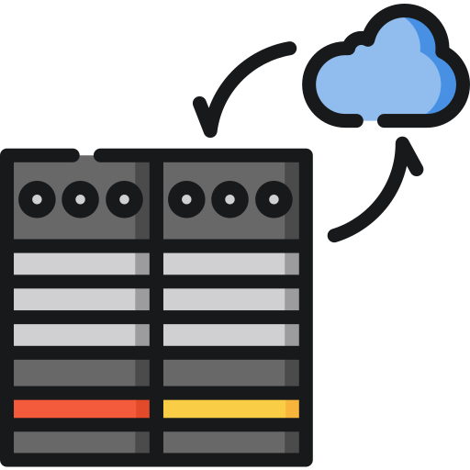
Azure Private DNS
Azure Private DNS provides a reliable, secure DNS service to manage and resolve domain names in a virtual network
Private DNS allows you to use your own custom domain names rather than the Azure-provided ones
It provides name resolution for virtual machines (VMs) within a virtual network and between virtual networks
Notes:
Which means that it is a unified space that provides access to blobs, queues, files and tables. Since general purpose storage account supports all type of storage data, it is one of the most used storage account in Azure.

Slide 51
Network Security Groups

Slide 52

Azure Security Group
A network security group is used to encapsulate rules to filter incoming and outgoing traffic to and from several types of Azure resources
For each rule, you can specify source and destination, port, and protocol
Notes:
Which means that it is a unified space that provides access to blobs, queues, files and tables. Since general purpose storage account supports all type of storage data, it is one of the most used storage account in Azure.

Slide 53
Security Rules

Slide 54
Azure Security Rules
A Security Rule is used in Azure to specify some constraint on incoming or outgoing traffic.
Each rule specifies some properties
Notes:
Which means that it is a unified space that provides access to blobs, queues, files and tables. Since general purpose storage account supports all type of storage data, it is one of the most used storage account in Azure.

Slide 55
Security Rule Properties

Slide 56

Security Rule Properties
Name
It is a unique name within the network security group which is used to identify and refer to a rule
Priority
Source or destination
Protocol
Direction
Port range
Action
Notes:
Which means that it is a unified space that provides access to blobs, queues, files and tables. Since general purpose storage account supports all type of storage data, it is one of the most used storage account in Azure.

Slide 57
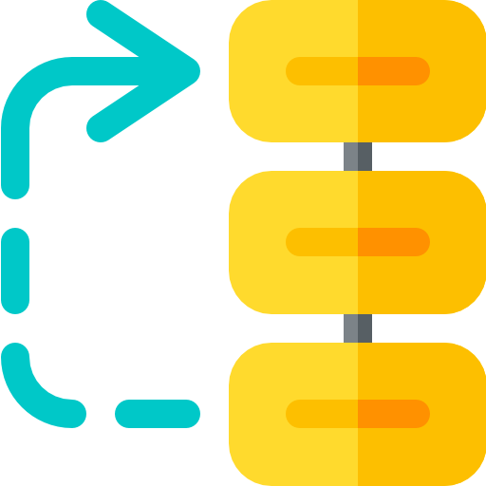
Security Rule Properties
Name
It indicates a number between 100 and 4096. Rules are processed in priority order, with lower numbers processed before higher numbers. Once traffic matches a rule, processing stops
Priority
Source or destination
Protocol
Direction
Port range
Action
Notes:
Which means that it is a unified space that provides access to blobs, queues, files and tables. Since general purpose storage account supports all type of storage data, it is one of the most used storage account in Azure.

Slide 58
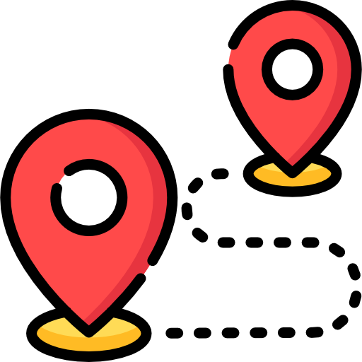
Security Rule Properties
Name
Any, or an individual IP address
Priority
Source or destination
Protocol
Direction
Port range
Action
Notes:
Which means that it is a unified space that provides access to blobs, queues, files and tables. Since general purpose storage account supports all type of storage data, it is one of the most used storage account in Azure.

Slide 59

Security Rule Properties
Name
TCP, UDP, ICMP, or others
Priority
Source or destination
Protocol
Direction
Port range
Action
Notes:
Which means that it is a unified space that provides access to blobs, queues, files and tables. Since general purpose storage account supports all type of storage data, it is one of the most used storage account in Azure.

Slide 60

Security Rule Properties
Name
It indicates whether the rule applies to inbound or outbound traffic
Priority
Source or destination
Protocol
Direction
Port range
Action
Notes:
Which means that it is a unified space that provides access to blobs, queues, files and tables. Since general purpose storage account supports all type of storage data, it is one of the most used storage account in Azure.

Slide 61
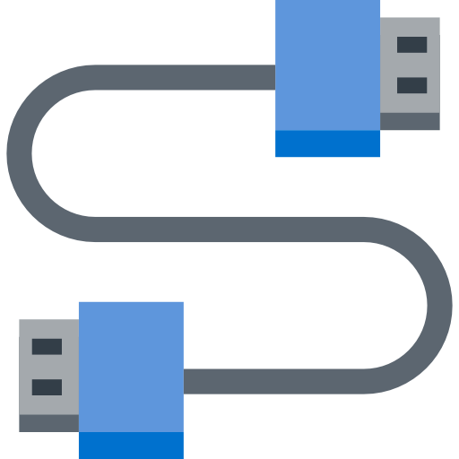
Security Rule Properties
Name
You can specify an individual or range of ports for your rules. Specifying ranges enables you to create fewer security rules
Priority
Source or destination
Protocol
Direction
Port range
Action
Notes:
Which means that it is a unified space that provides access to blobs, queues, files and tables. Since general purpose storage account supports all type of storage data, it is one of the most used storage account in Azure.

Slide 62
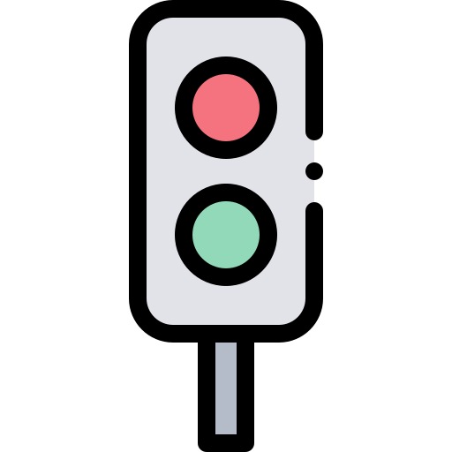
Security Rule Properties
Name
Action indicates whether to allow or deny traffic
Priority
Source or destination
Protocol
Direction
Port range
Action
Notes:
Which means that it is a unified space that provides access to blobs, queues, files and tables. Since general purpose storage account supports all type of storage data, it is one of the most used storage account in Azure.

Slide 63
Hands-on: Create NSG

Slide 64
Hands-on: Attach NSG to a Subnet

Slide 65
Hands-on: Verify NSG is Applied

Slide 66
Service Tags

Slide 67

Service Tags
A service tag is used to group IP Addresses to make it easy to apply security rules.
Service tags allow easy creation and allow to minimize complexity of rule creation.
Service Tags are managed by Azure. You cannot create or assign your own service tags.
Notes:
Which means that it is a unified space that provides access to blobs, queues, files and tables. Since general purpose storage account supports all type of storage data, it is one of the most used storage account in Azure.

Slide 68
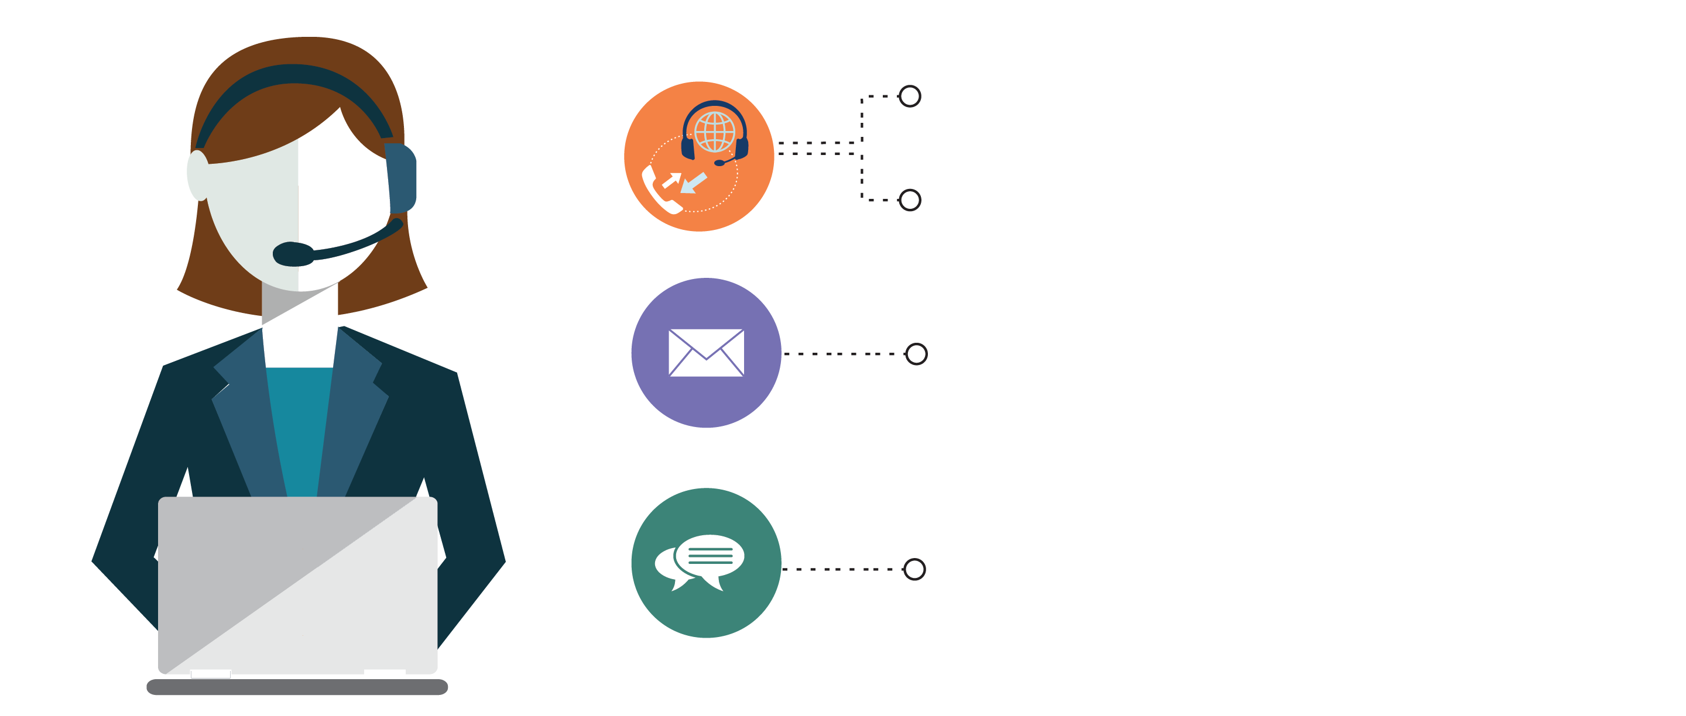
India: +91-7847955955
US: 1-800-216-8930 (TOLL FREE)
support@intellipaat.com
24/7 Chat with Our Course Advisor
Notes:
Thank you!

